Slide 1
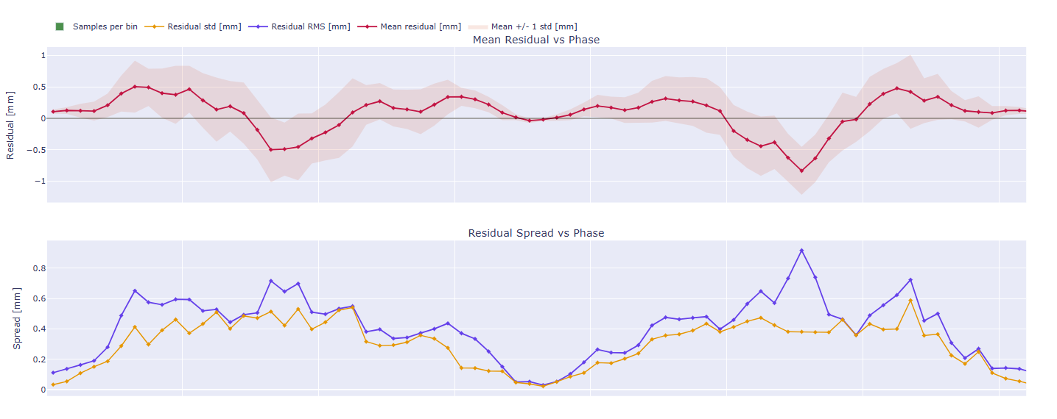
Ver 3, 500 RPM

Slide 2
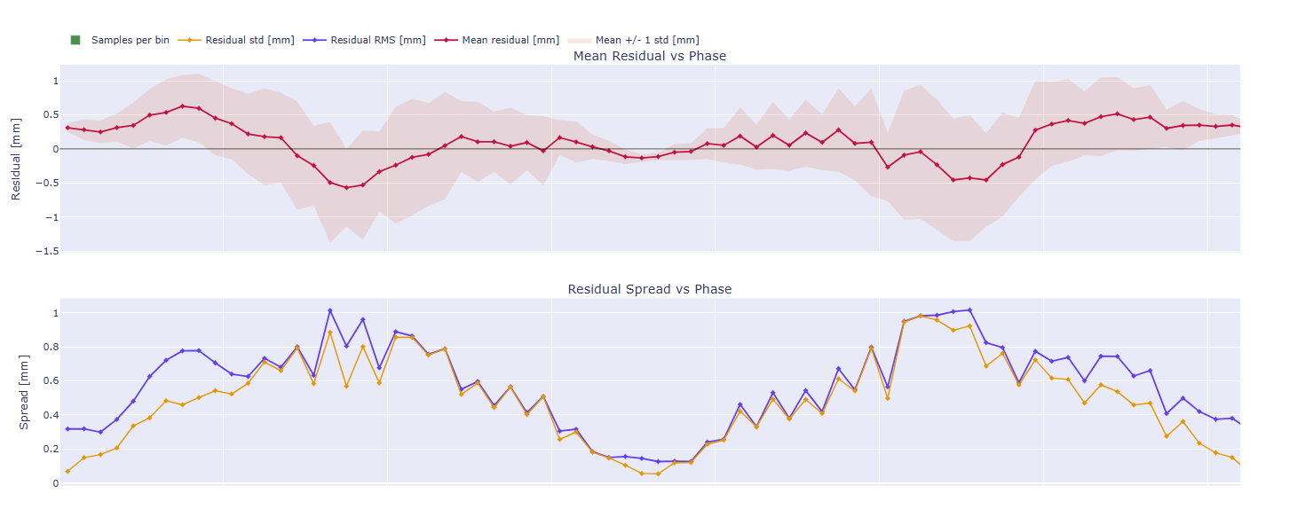
Ver 3, 750 RPM

Slide 3
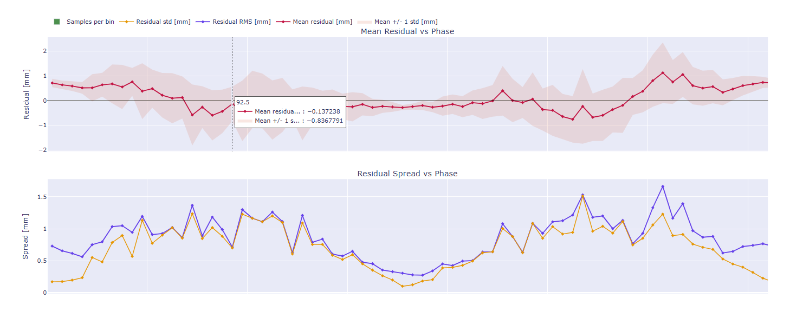
Ver 3, 1000 RPM

